Slide 1
Calculator

Slide 2
Abacus
It is an instrument that is used to calculate or count by using sliding counters and a rod. It was indeed the world's first calculator. It was first used in India, Europe, China, and Russia.

Slide 3
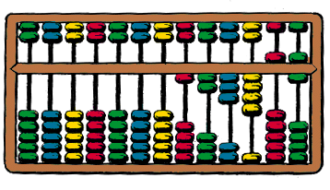
Abacus

Slide 4
Electronic Calculator
The most simple mathematical operations: addition, subtraction, multiplication, division.

Slide 5
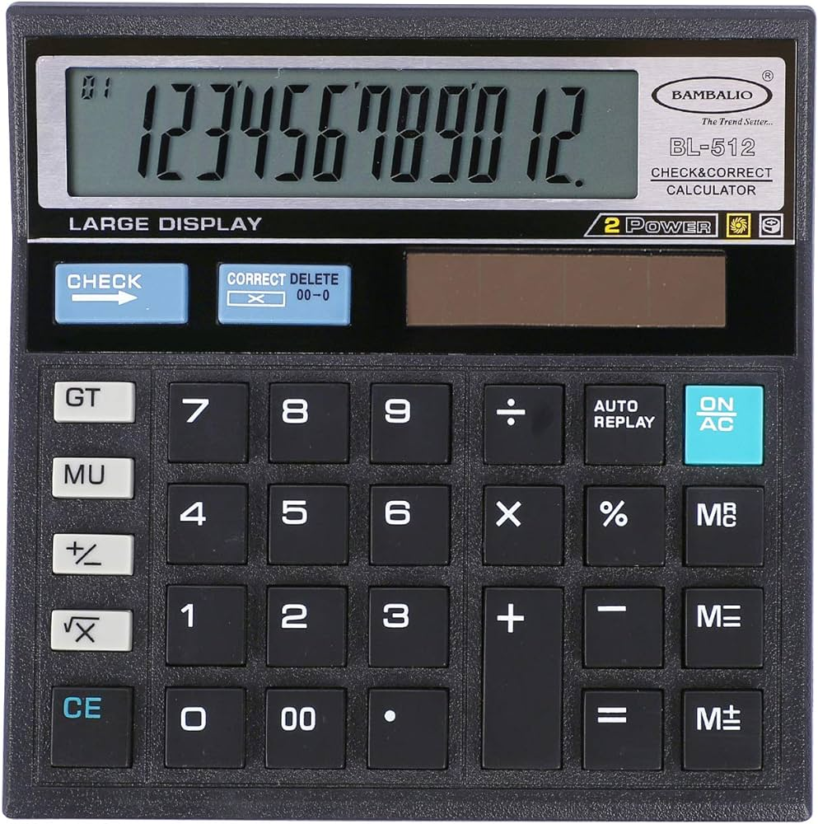

Slide 6
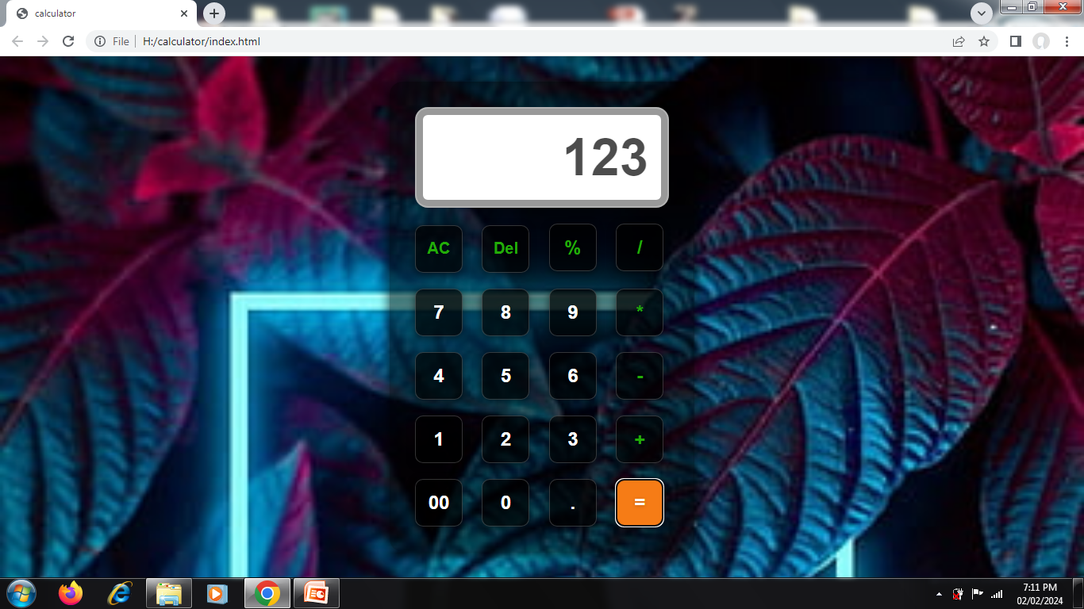
Online Calculator

Slide 7
For making online calculator we used
HTML (Hyper Text Markup Language)
CSS(Cascading Style Sheets)
Java script

Slide 8
HTML code
<!DOCTYPE html>
<html lang="en">
<head>
<meta charset="UTF-8">
<link rel="stylesheet" href="style.css">
<meta name="viewport" content="width=device-width, initial-scale=1.0">
<title>calculator</title>
</head>
<body>
<div class="calculator">
<input type="text" placeholder="0" id="inputBox" readonly>
<div>
<button class="operator ac">AC</button>
<button class="operator del">Del</button>
<button class="operator">%</button>
<button class="operator">/</button>
</div>

Slide 9
<div>
<button>7</button>
<button >8</button>
<button >9</button>
<button class="operator">*</button>
</div>
<div>
<button>4</button>
<button >5</button>
<button >6</button>
<button class="operator">-</button>
</div>
<div>
<button>1</button>
<button >2</button>
<button >3</button>
<button class="operator">+</button>
</div>

Slide 10
<div>
<button>00</button>
<button >0</button>
<button >.</button>
<button class="equal-btn">=</button>
</div>
</div>
<script src="script.js"></script>
</body>
</html>

Slide 11
CSS code
*{margin: 0;
padding: 0;
box-sizing: border-box;
font-family: sans-serif;
font-weight: bold;
}
body{
width: 100%;
height: 100vh;
display: flex;
justify-content: center;
align-items: center;
background: url(back.jpg);
background-size: cover;
}
.calculator{
padding: 20px;
border: 2px solid #0000;
border-radius: 16px;
box-shadow: 0px 3px 15px rgba(0,0,0,0.8);
background: rgba(0,0,0, 0.5);
}

Slide 12
input{
width: 320px;
padding: 24px;
margin: 10px;
border-radius: rgba(255,255,255,0.3);
box-shadow: inset 0px 0px 0 8px rgb(0, 0,0,0.4);
font-size: 65px;
text-align:right;
color: rgb(0,0,0,0.7);
border: solid 2px rgba(0,0,0,0.3);
border-radius:16px;
text-shadow:0px,1px,5px,rgba(0,0,0,0.2);
}
input::placeholder{
color:rgb(92, 20, 148);
}

Slide 13
button{
width: 60px;
height: 60px;
margin: 10px;
color:#fff;
background: rgba(0,0,0, 0.7);
font-size: 24px;
cursor: pointer;
border: solid 1px rgba(255,255,255, 0.2);
border-radius: 10px;
text-shadow: 0px 1px 5px rgba(0,0,0,0.2);
box-shadow:-1px 2px 10px rgba(0,0,0,0.5);
}
.ac, .del{
font-size: 20px;
}

Slide 14
button:hover{
color: #fff;
background: #f67c16;
}
.equal-btn{
background: #f67c16;
}
.operator{
color:#23ac08;
}

Slide 15
Java script code
let display = document.getElementById('inputBox');
let buttons = document.querySelectorAll('button');
let buttonsArray = Array.from(buttons);
let string ='';
buttonsArray.forEach(btn => {
btn.addEventListener('click',(e)=> {
if(e.target.innerHTML == 'DEL'){
string = string.substring(0, string.length-1);
// display.value = string;
}
else if(e.target.innerHTML == 'AC'){
string ='';
display.value = string;
}

Slide 16
else if(e.target.innerHTML == '='){
string = eval(string);
display.value = string;
}
else{
string += e.target.innerHTML;
display.value = string;
}
});
});

Slide 17
Advantages
Accessibility from any device with an internet connection.
Expanded functionality with a wider range of functions and capabilities.
Regular updates and upgrades without the need to purchase a new calculator.

Slide 18


